Slide 1


The Power of Perspective
Steve Minick, LPC
Director of Programs
Family Services of NW PA
A Founding Member of ECTIC
stevem@fsnwpa.org
Notes:
1

Slide 2
Learning Objectives
1. Participants will increase knowledge and understanding of personal perspective and how it is aligned with resilience.
2. Participants will increase knowledge and understanding of the power and benefits of perspective taking.
3. Participants will explore ways human nature and thinking errors impact perspective and how to overcome them for greater compassion satisfaction and vicarious resilience.
Notes:
2

Slide 3

Resilience
Notes:
3

Slide 4
What Makes Perspective a Building Block
“ Your living is determined no so much by what life brings to you as by the attitude you bring to life; not so much by what happens to you as by the way your mind looks at what happens” Kahlil Gibran
“It is not the things themselves that which trouble us but the opinions we have about these things” Epictetus
“You can’t avoid suffering in your life, but you can avoid suffering about the suffering” Leonard Wolf
“I am an old man and have suffered through a great many troubles, most of which never actually happened” Mark Twain
Notes:
4

Slide 5
Perspective Defined
The lens through which we interpret and assign meaning to the information gathered through perception
Unique point of view , shaped by our life experiences, beliefs, values, and emotions
A particular attitude toward or way of regarding something
To put something in perspective we clarify, appraise, or assess the true value, importance, or significance of something
Notes:
5

Slide 6
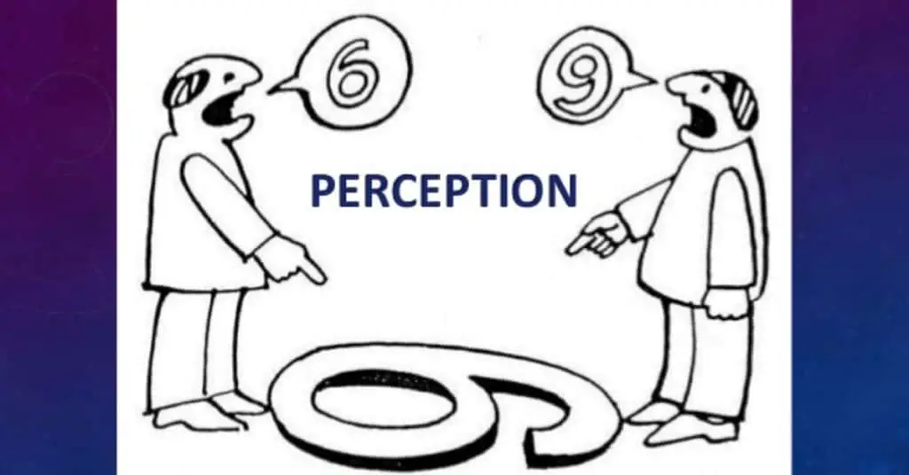
Notes:
6

Slide 7
Perception vs. Perspective
Perception lays the foundation for perspective
Something you can infer from using the senses (sight, sound, taste, smell, touch)
Perspective is how we look at the world after reflecting on our perception
Perceptions influence perspective, and they may or may not be accurate

Slide 8
Notes:
8

Slide 9
The Power of Perspective Taking
The ability to take on someone else’s point of view
The act of perceiving a situation or understanding a concept from an alternative point of view such as that of another individual
Powerful tool to expand our own perspective by learning from the way others see life
Notes:
9

Slide 10
Benefits of Perspective Taking
Building empathy
Learning and Growth
Counteracts expressions of bias – decreases implicit bias
Reduces expression and accessibility of social stereotypes
Increases team creativity
Stabilizes marriages relationships
Improves conflict resolution
What is Perspective taking ? The basics & benefits explained Amy Lou Abernethy cites sources
Notes:
10

Slide 11
Why Is It So Hard to Keep a Healthy Perspective
1st Dart, physical and mental discomfort inescapable
2nd Dart, the reactions we throw ourselves
Inaccurate or incomplete information GIGO
Cognitive distortions/biases/mistaken beliefs/logical fallacies
Desire to be right and protect our ego
Notes:
11

Slide 12
Improving Perspective
Choose healthy humility
Discipline your mindset
Admit when you are wrong
Positive inner monologue
Notes:
12

Slide 13
Shifting Perspective
Reframe your thoughts
Change your inputs
Distance self from negativity
Manage expectations
Use a wide-angle lens
Perform a good deed

Slide 14
Gaining/Regaining Perspective
Benefit finding/sense making
Reconnect with purpose/values
Follow your awe
Yes/and thinking
Put setbacks in context
Let go of judgement
Can’t move forward without acknowledging

Slide 15
Invitation to Possibility Land
Possibility therapy is about acknowledging and validating clients felt experience and ideas about their lives while ensuring that possibilities for change are discovered and amplified
“Clients are like rivers. You cannot step into the same part of them twice. Where clients start is not an indication of all they are or where they will wind up” O’Hanlon &Beadle
Notes:
15

Slide 16
Strength Based Approaches
Trauma Informed Care is a strength-based approach (it is in the SAMHSA definition)
Heroic stories – casting people in the role of the primary agents of change
Diagnosis and problem descriptions tell a story and many other stories of survival and courage simultaneously exist – Miller

Slide 17
Strengths Based Assessment
When I get to know you better what qualities and strengths will I come to admire about you as a [family, person, parent, spouse, etc.] Scott Sells FST
What are qualities that describe you when you are your very best- what were you doing when these aspects became apparent – what kind of person do these aspects describe - what kind of person do these aspects show an aspiration toward
What are the qualities others would describe in you when you are at your very best..
What accomplishments are people proud of for themselves/for one another- what do they want themselves and/or other family members to accomplish
When I am at my best, I am…

Slide 18
Benefits of Gratitude
Strong positive correlation between gratitude and resiliency
Compliments I would like to give myself today
Current challenges and what I am learning from them
People I am grateful for
Significant assets in my life at present

Slide 19
Curiosity
Exploring and satisfying your curiosity floods your brain with dopamine
3 types of curiosity
Diversive – attraction to everything novel
Epistemic – desire to learn and understand
Empathic – interest in the thoughts and feelings of others
A curious mind allows us to ask questions and question ourselves

Slide 20
Three Primary Perceptual Positions
1st position/self (own shoes)
2nd position/other (their shoes)
3rd position/observer (outsider’s shoes)

Slide 21
Equanimity – Balance of Mind (Hanson)
Not reacting to your reactions
Space around your experiences buffer between you and their feeling tones
Present in the world but not upset by it
Story of Maybe

Slide 22
Scuba Metaphor for Practicing Resilience
When I am nearly out of reserves, I need to act. I cannot continue to be an effective helper to others if I have nothing left in my tank. Am I checking my reserves soon enough?
Do I have enough in my tank to get myself to safety? When I emerge from the depths, what do I need to refill my tank?
Notes:
22

Slide 23
“Joe Heller”
A Poem by Kurt Vonnegut
New Yorker 2005
Notes:
23

Slide 24
Bibliography
Bloom - Psych, The Story of the Human Mind
Duncan, Miller, Sparks - The Heroic Client, A Revolutionary Way to Improve Effectiveness Through Client-Directed, Outcome-Informed Therapy
Frankl - Man’s Search for Meaning
Hanson, Mendius - The Practical Neuroscience of Buddha’s Brain, Happiness, Love & Wisdom
Harari - 21 Lessons for the 21st Century

Slide 25
Bibliography
Kegan - In Over Our Heads; The Mental Demands of Modern Life
Knight - NLP at Work
Mate - The Myth of Normal
O'Hanlon - Quick Steps to Resolving Trauma
O’Hanlon, Beadle - A Field Guide to Possibility Land: Possibility Therapy Methods
Sapolsky - Why Zebras Don’t Get Ulcers

